Slide 1
Introduction to networking

Slide 2
CCNA R&S Modules(200-125)
Network Fundamentals
LAN Switching Technologies
Routing Technologies
WAN Technologies
Infrastructure Services
Infrastructure Security
Infrastructure Management

Slide 3
Network and Networking
Networking is the component in your device i.e. your tablet, computer, mobile that has knowledge to know where the network is to connect to and what the rules are for connecting to that network.
Device is connected to the network through wired or wireless.
Network is the medium that used to connect two or more device together so that they can actually share information

Slide 4
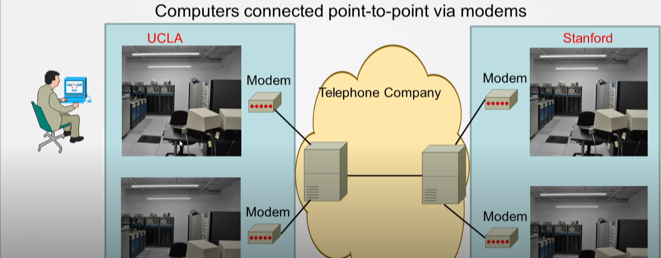
Early days of networking

Slide 5
Terms you should be familiar with
There are some terms that are common with you devices at your home like tablet, pc etc. and networking devices.
CPU(central processing unit)
MEMORY
NIC (Network interface card)
APPLICATIONS
Network aware
Network unaware

Slide 6
Physical Components of Network - Hosts
Host is the device at the edge of the network that is creating the data or the devices at far end of network that is receiving the data
Hosts
Laptops
PCs
Smartphones
Tablets
Servers

Slide 7
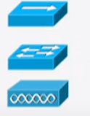
Physical Components of Network- Network Infrastructure
Now everything at the middle that allows the data to travel from point A to point B, we call that network infrastructure.
Network infrastructure is divided into several classes of devices.
Network Access Devices
It is the very first network device to which your end device i.e your host is connected to. These are providing you the access to the network.
Hubs
Switches
Access points

Slide 8

Physical Components of Network- Network Infrastructure
Network Infrastructure Devices
These are the devices that do not typically connected to the hosts.
Routers
Firewalls

Slide 9
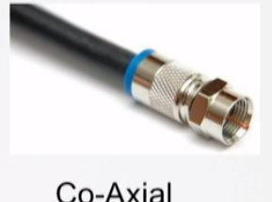
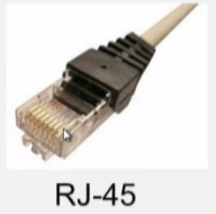
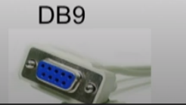
Cable Types
Copper Cable (LAN)
Used for shorter distance
Co-axial cable
Twisted pair
Shielded
Unshielded
Copper Cable(WAN)
Used for longer distance
Serial Cables

Slide 10
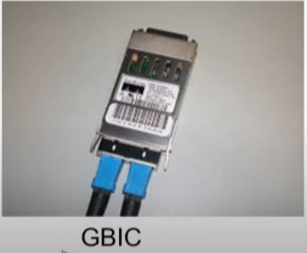
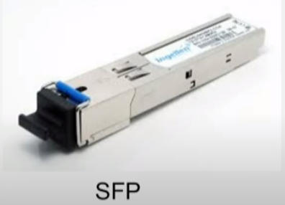
Cables - Optics
Fiber optical cables
These cables use light to transmit the data instead of using electrical energy. The light can be laser light of it is transmitting data very long distance or it can be LED if it is sending data to shorter distance.
Fiber Cables
MMF(multi mode fiber)-used for shorter distance
SMF(single mode fiber)-used for longer distance
Connectors
GBICs(gigabit interface connector)
SFP(small form-factor pluggable, smaller in size)

Slide 11
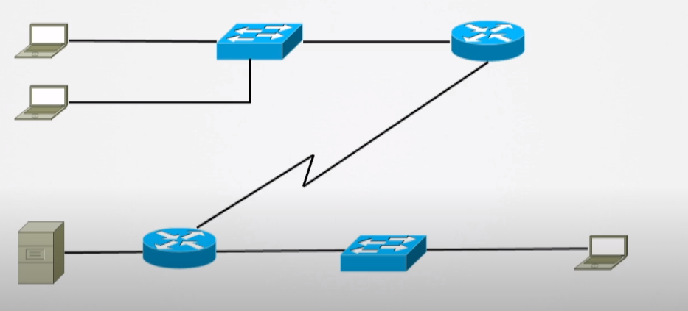
Network/topology diagram
Network/topology diagram is the visual representation of network like a map.

Slide 12
Topologies – Logical and Physical
Logical Topology
What the network look like to the end device
Physical Topology
How the network is actually cabled. It contain every component in between the 2 devices connecting them.
Bus
Star
Ring

Slide 13
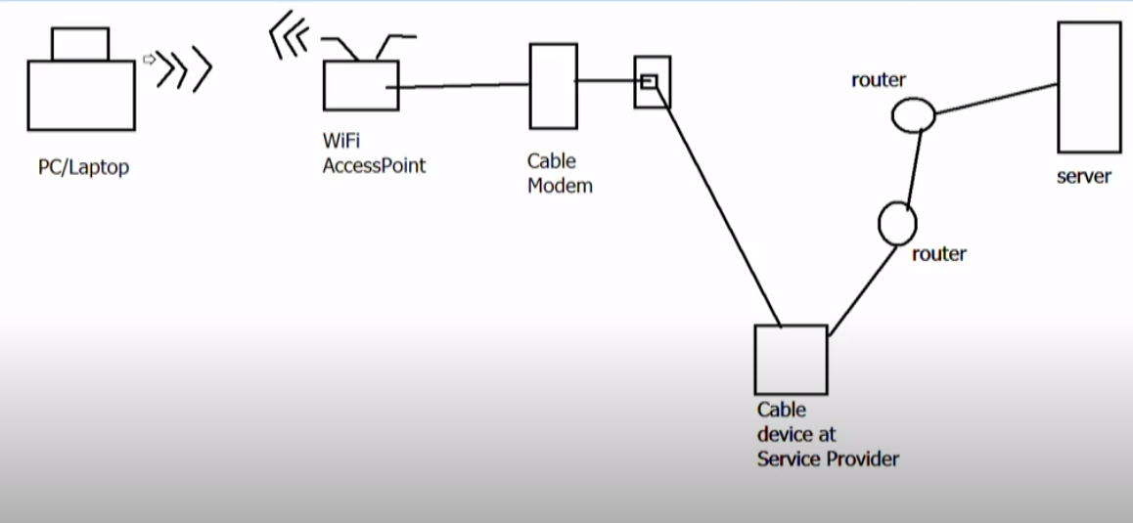
Example – Physical Topology

Slide 14
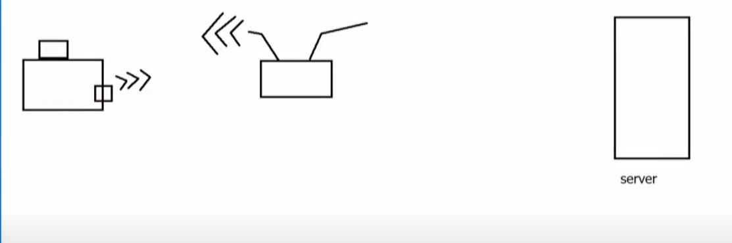
Example – Logical Topology

Slide 15
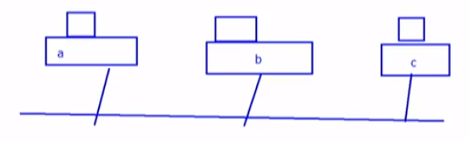
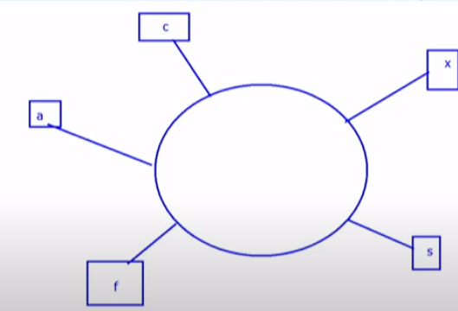
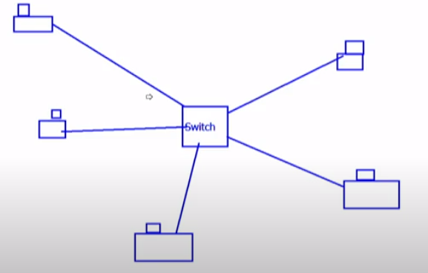
Physical Topologies types
BUS
All devices are on same network and
all of them are able to see each other. They
don’t need any other device to communicate.
Ring
Here multiple devices are connected to each other
through a ring. Here also everybody can talk to everybody
else directly.
Star
Sometimes called the hub and spoke topology.
Here devices are connected to one central device
Typically a switch.

Slide 16
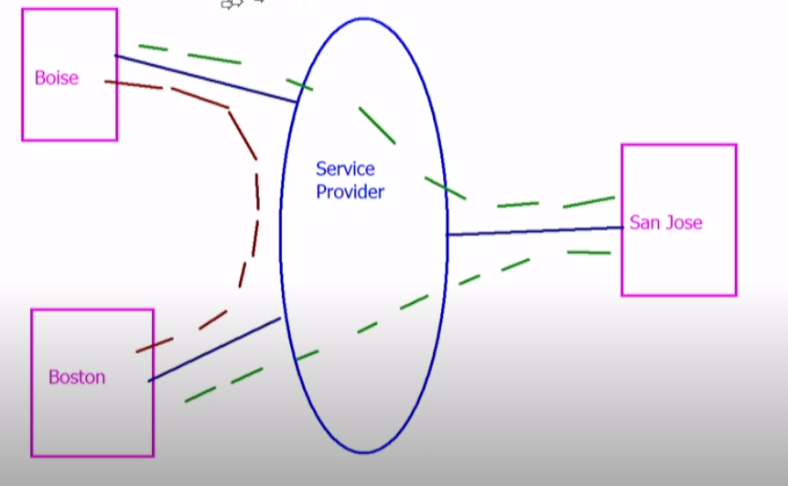
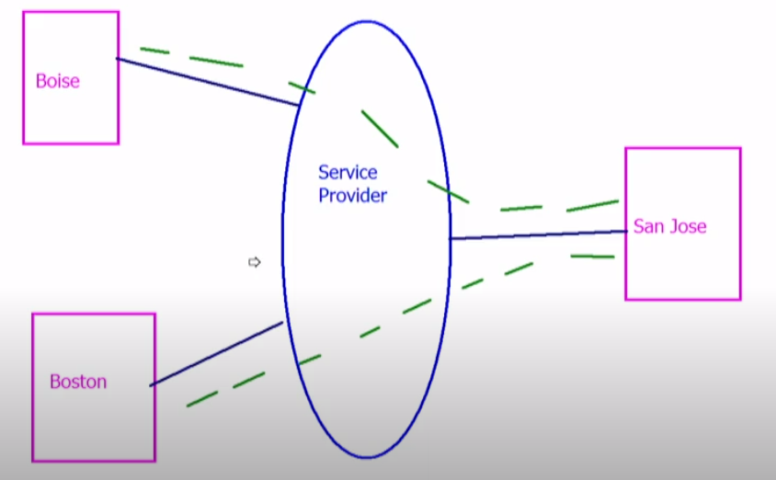
Fully-Meshed and Partially-Meshed
In fully-meshed network everybody connected to that network can talk to everybody else.
Here every location will
have a connection to
every other location.
In partially-meshed connection Boise and Boston will talk to each other through San Jose.

Slide 17
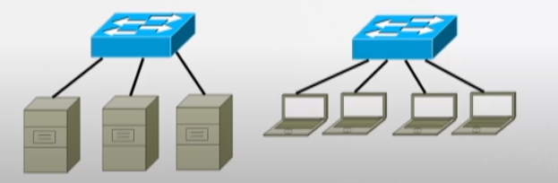
Putting it all together
Cisco’s Three Layer Hierarchical Design.
Access Layer
All the hosts and access devices are in this layer.
What types of things are going on at Access layer.
Layer-2 Switching
Port security
Spanning Tree
High Availability(multiple Switches)
Power over Ethernet

Slide 18
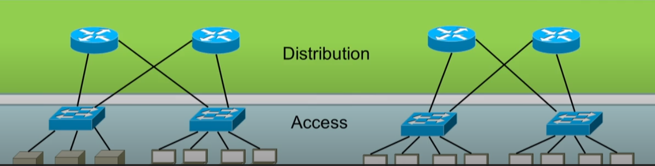
Cisco’s Three Layer Hierarchical Design.
Distribution Layer
At distribution layer you are going to find routing and security.

Slide 19
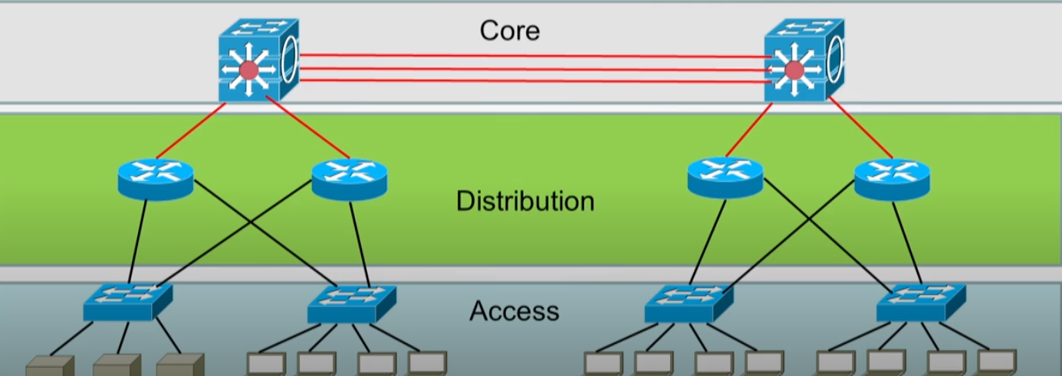
Cisco’s Three Layer Hierarchical Design
Core layer
Core layer is also known as network backbone that provides high speed network device connections to switch packets, switch data as fast as possible from one part of the network to other. This layer consist of includes the high-end switches and high-speed cables such as fiber cables. In addition, no packet manipulation is done by devices in this layer.

Slide 20
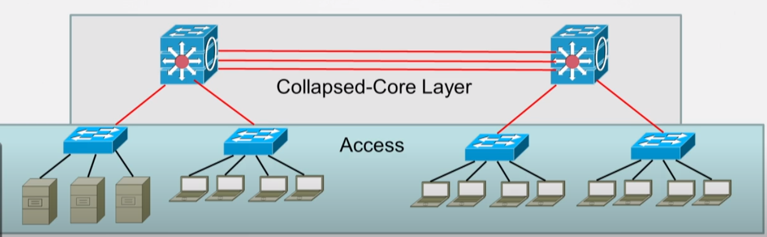
Collapsed core design
Here the Core and distribution has been collapsed together. It means one device is performing the tasks of core as well as distribution layer.

Slide 21
Impact of Infrastructure Components
Describe the impact of infrastructure components in the Enterprise network
This section is there to see if you are having understanding of firewalls, Wi-Fi access points, Wi-Fi NIC cards and what impact they are having on traffic within an enterprise network.

Slide 22
Firewall
Inline system that enforce an access control policy between various network segments defined as security zones.
Can be software or hardware.
Usually deployed at network edge (Internet, WAN links)
It has to be resistant to attacks against itself.
Usually deployed as layer 3 hop, thus it is reachable by attacker
Attacker cannot take-over the firewall

Slide 23
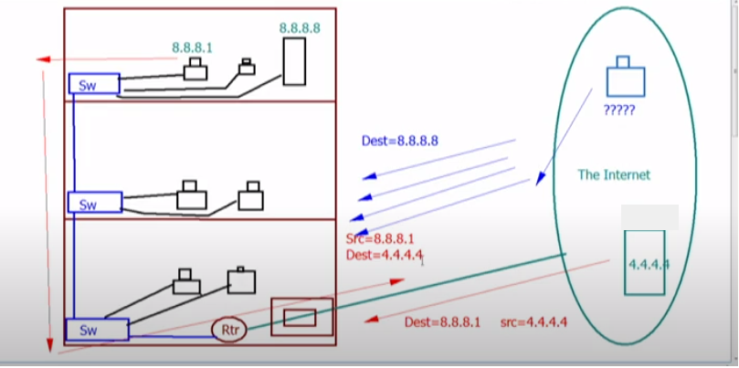
Firewall

Slide 24
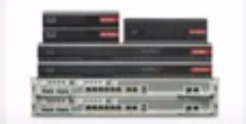
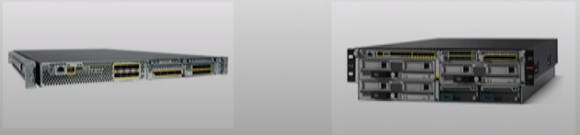
Firewalls
Cisco’s current line of firewalls:
ASA’s : Adaptive security appliances
Firepower :

Slide 25
How do firewall impact the network?
If they operate correctly they have a huge security benefit.
If Firewalls become overloaded, they could be a source of traffic congestion, delays or packet drops.
Misconfigured firewalls, or internal applications that are misbehaving, could block access to legitimate resources.
They add an additional element to the network that must be monitored.

Slide 26
Wi-Fi Components in Enterprise Networks (1)
Access Points
Access points can be standalone boxes or routers and switches have component built into them.
Access points comes in variety of options
Indoor
Outdoor
Managed (locally or cloud ) Managed by the controller
Unmanaged (Standalone)
Wi-Fi NICs

Slide 27
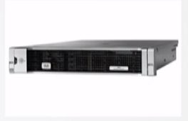
Wi-Fi Components in Enterprise Networks (2)
Controller
A variety of options.
Standalone
Can control different maximum quantities of APs

Slide 28
How do Wi-Fi Components impact the network?
Reduced cost of implementing wired cabling.
Many devices not even have the wired LAN connections (i.e. tablet, smartphones, etc.)
Allows for roaming.
Aps can become overloaded with traffic causing latency or even the inability to connect to the network as it is a shared resource.
Typically recommended to pair with security.

